Slide 1
CSC-430(001) / 530: Database Management Systems / Database Theory
Lab 4: Introduction to Views and Triggers

Slide 2
A - Uses of views?
To hide some data from some users.
To make queries easier to execute by creating a virtual relations.
For creating modules of the database and giving access to only targeted users.

Slide 3

Views
Logical Level (Virtual relations)
Tables
Conception Level
(Stored relations)
Data storage
Physical Level

Slide 4
Defining a View
CREATE VIEW viewname as
< Select Query >;
CREATE VIEW viewname (attr1, attr2) as < Select (attr1, attr2) Query >;
ALTER VIEW viewname (attribute1) as < Select (attribute1) Query >;
DROP VIEW viewname;

Slide 5
Modifications of views (INSERT, DELETE, UPDATE)
A View is not updatable if it contains any of the following:
Aggregate functions (SUM(), MIN(), MAX(), COUNT())
DISTINCT
GROUP BY
HAVING
UNION or UNION ALL
Subquery in the SELECT clause
Non-updatable view in the FROM clause

Slide 6
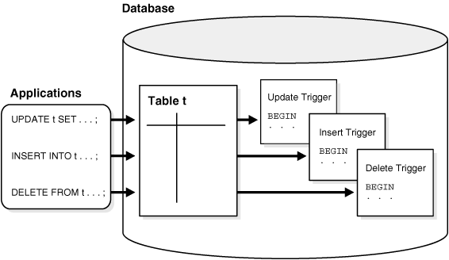
B - Why Learn Triggers?
Triggers allow specified actions to be performed automatically within the database, without having to write any extra application code.
Triggers increase the power of the database, and the power of your application.
Triggers allow for complex application logic to be executed while being “close” to the data.
verify any anomalies that pertain to operations of insert, delete, and update

Slide 7
Triggers – close to “data”
verify any anomalies that pertain to operations of insert, delete, and update

Slide 8
Possible Uses for Triggers
Enhance complex database security rules
Create auditing and logging of records automatically
Prevent tables from being accidentally dropped
Prevent invalid DML transactions from occurring
Enforce data integrity rules

Slide 9
More Uses…
Generate derived column values automatically
Maintain synchronous table replication
Gather statistics on table access
Modify table data when DML statements are issued against views

Slide 10
Trigger Syntax
General form:
Event - request to execute database operation
Condition - predicate evaluated on database state
Action - execution of procedure that might involve database updates
ON <event> IF <condition> THEN <action>
Example:
ON <updating maximum course enrollment> IF <number registered is greater than new
max enrollment limit> THEN <deregister students>

Slide 11
Trigger Syntax (cont…)
Events: INSERT, DELETE, or UPDATE (alter) statements or changes to individual rows caused by these statements
Condition: Anything that is allowed in a WHERE clause
Action: An individual SQL statement or stored procedures

Slide 12
Trigger Syntax (cont…)
Consideration:
Conditions can refer to the state of the affected row or table BEFORE or AFTER the event occurs
Notation:
The reference to the tuple used in the transaction, before or after the execution of the triggering event is specific to the operation
Use SET operator to modify fields of table that are activated the trigger.
INSERT | DELETE | UPDATE
NEW |  | NEW
 | OLD | OLD

Slide 13
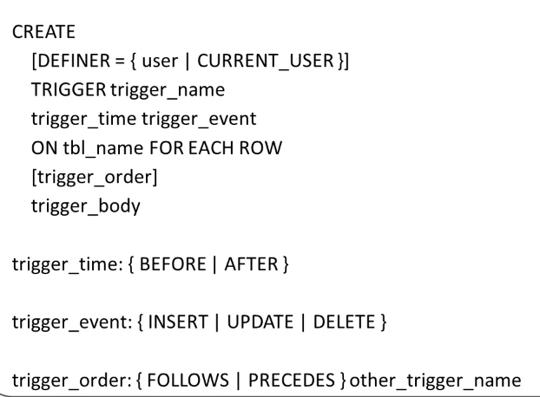
Trigger Syntax (cont…)

Slide 14
Write a trigger to UPDATE the address of a student with the 'Ruston' BEFORE INSERT’-ing the record in the students table IF the address is null.
HANDS ON # 1
DELIMITER $$
CREATE TRIGGER ‘newdb2’.‘STUDENT_BEFORE_INSERT’
BEFORE INSERT ON STUDENT
FOR EACH ROW
BEGIN
IF (NEW.ADDRESS is null) THEN
SET New.ADDRESS = 'Ruston';
END IF;
end$$
DELIMITER ;
INSERT INTO STUDENT(SID, Name, Address) VALUES ("S006", ”Francis", null);

Slide 15
Write a trigger to enforce the following constraint : Bank clients must be at least 18 years old, If Age is lesser than 18, the client’s information is discarded.
HANDS ON # 2
CREATE TABLE CLIENT (
clientID INT NOT NULL ,
name VARCHAR(45) NULL ,
Age INT NULL ,
PRIMARY KEY (`clientID`) );
INSERT INTO client (`clientID`, `Name`, `Age`) VALUES (1, 'client1', 21);
INSERT INTO client (`clientID`, `Name`, `Age`) VALUES (3, 'client3', 18);

Slide 16
Write a trigger to enforce the following constraint : Bank clients must be at least 18 years old, If Age is lesser than 18, the client’s information is discarded.
HANDS ON # 2
DELIMITER $$
CREATE TRIGGER client_DateOfBirt
BEFORE INSERT on client
FOR EACH ROW
BEGIN
declare msg varchar(255);
IF (NEW.Age < 18 ) THEN
/* Cause Error Message */
set msg = 'Invalid Date of Birth';
signal sqlstate '45000' set message_text = msg;
END IF;
END
$$
DELIMITER ;

Slide 17
Write a trigger to keep track of password changes.
HANDS ON # 3
CREATE TABLE users (
username VARCHAR(45) NOT NULL ,
email VARCHAR(45) NOT NULL ,
password VARCHAR(45) NULL ,
PRIMARY KEY (username,email) );
CREATE TABLE users_logs (
username VARCHAR(45) NOT NULL ,
oldpassword VARCHAR(45) NULL ,
newpassword VARCHAR(45) NULL);
INSERT INTO USERS VALUES('USER1','USER1@MAIL.COM',123);

Slide 18
Write a trigger to keep track of password changes.
HANDS ON # 3
DELIMITER $$
CREATE TRIGGER track_password
AFTER UPDATE ON Users
FOR EACH ROW
BEGIN
IF(New.password <> Old.password) Then
INSERT INTO users_logs VALUES(New.username, Old.password, New.password);
END IF;
end$$
DELIMITER ;
UPDATE users SET password='475' WHERE username='user1';

Slide 19
Write a trigger to assign a coursenum 101 in the ‘Business’ department to every new student.
HANDS ON # 4
DELIMITER $$
CREATE trigger NEW_STUDENTS
AFTER INSERT ON STUDENTS
FOR EACH row
BEGIN
INSERT into take values(New.SID,101,'Business',0,0);
END$$
DELIMITER ;
Error Code: 1136. Column count doesn't match value count at row 1

